Slide 1

Brief guide on usage of LMAC4.6.x
(beta)

Slide 2
Basic Requirements
Python 3.7 with below libraries
Pandas and dependent libraries
Openpyxl
xlrd
Pysimplegui
jinja2

Slide 3
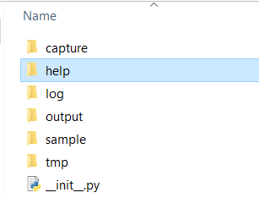
Get it
Download zip
Extract it to a Folder
(keep folder structure as is)

Slide 4

HOW TO USE
Follow the steps

Slide 5
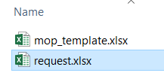
Step1: Update request.xlsx file with received request.
Update request.xlsx file with received ACL Rule update requests ( can do copy-paste).
Just add last column “customer_name” for each row.
Do Not change column headers in request.xlsx
Save and exit.
N.B. Input file can be selected from Power Options / settings.txt

Slide 6
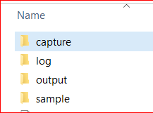
Step2: Capture Output from Devices
Capture the output of below 4 (four) commands and save it
single file per device
Log file format should be: hostname.log
Keep all devices log files under capture folder.
Commands to take output from device. (do not alter/trunk spelling)
show route
show run
show run access-group
show access-list | ex (^ )
Capture Folder can be changed from Power Option/Settings.txt

Slide 7

Step3: Execute
Double-click / Run: main.py file.
Change inputs if needed for GUI Box. Go….

Slide 8
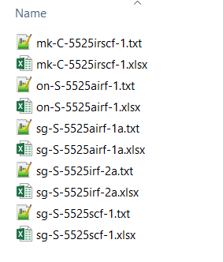
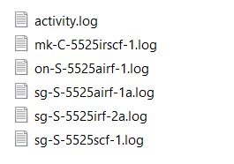
Wait & Watch
OUTPUT FOLDER
Wait for script to finish.
Watch out log folder for
activity log
error appeared during execution for device.
Master activity.log and individual device log will be created.
Check output folder for
delta configuration changes (Text files)
MOP (Excel Files)
Files will be created with respective device hostname.
LOG FOLDER

Slide 9
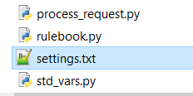
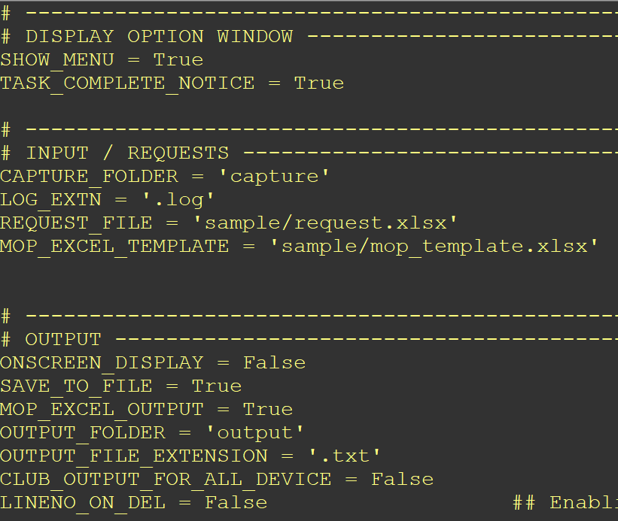
Options
Customize the Execution by changing settings.txt
Explore those by self.
Examples: “you can club output of all firewalls in single text file”, “Generate only text configuration, not mop excel”, and many more…
Variable Names are self-explanatory

Slide 10

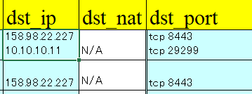
Notes
Request file:
Multiple IP Addresses allowed in a single cell. ( should be separated by Enter/New Line Character)
“dst_port” : contains combination of protocol port (should be separated by space in between). Multiple lines of protocol ports allowed.
Firewall names could be either in src_fw, dst_fw column(s).
Enter customer name in customer column.
NAT IP column could be selected instead of src/dst, if True value is set from settings.txt for respective value.
USE_SOURCE_NAT_IP
USE_DESTINATION_NAT_IP
Delete remark on split request will not happen as each request will be treat as individual.

Slide 11

Step5: Verify and update before apply
Verify generated delta changes from Text file.
Verify generated MOP File details from Excel file.

Slide 12
Includes
This is a beta version to check basic functionality and flow.
It includes New Rule Add/Remove request along with changes require in object groups.
This script is customize to meet JAPAN Firewall LMAC Requirement; where rules requires to be applied to given firewall(s). Plus it requires to find the necessary ACL, position of new Rule under specific remark based on Source subnet.
Generate Text Config Delta for each firewall
Generate Excel MOP File and do formatting.
Please contact (al202t@att.com) for any issue or bug observed on above.

